Slide 1
Chapter 25
Electric charge and Coulomb's law

Slide 2
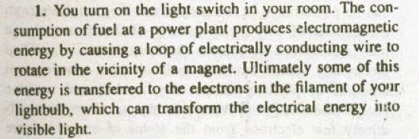
Electromagnetism : a preview

Slide 3
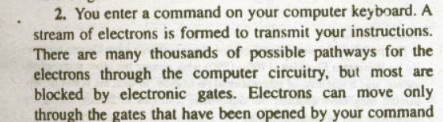

Slide 4
The common factors in these diverse phenomenon is that they all depend on the forces that we describe as electric or magnetic to direct the flow of flow of energy or particles.
Here in this course we will first study the electric phenomenon and then the magnetic phenomenon.
Later we will show that two cannot be separated: certain electric phenomena produce magnetic effects, and certain magnetic phenomena produce electric effects. This leads us to unify electric magnetic phenomena under name of electromagnetism.

Slide 5
Electric phenomena
Magnetic phenomena
electromagnetism

Slide 6
Evolution of electromagnetism

Slide 7
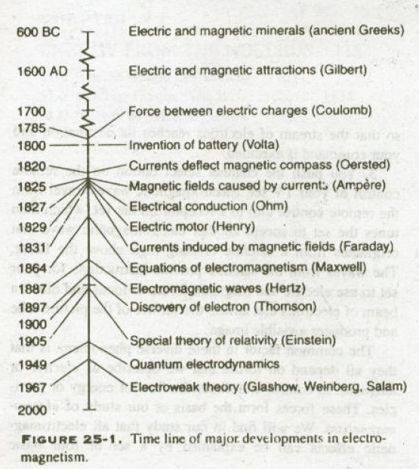

Slide 8
Electric charge
Electric charge is a physical property of matter that causes it to experience a force when near other electrically charged matter.
positive
negative

Slide 9
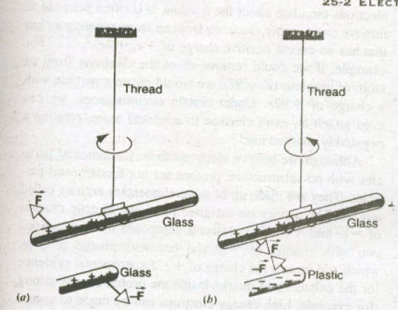


Slide 10
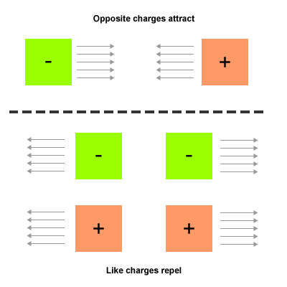

Slide 11
Electric forces between charges have many applications in industries:
Electrostatic paint spraying
Powder coating
Photocopier
Ink-jet printers…

Slide 12
Electric charge
Unit coulomb
A larger unit
1coulomb=charge of 6*10¹⁸ electrons
Symbol
Q
Scalar quantity

Slide 13
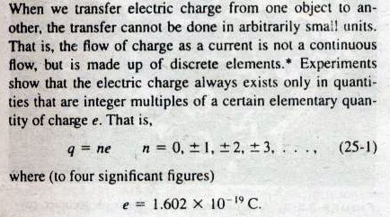
Electric charge is quantized

Slide 14
Coulomb's law

Slide 15
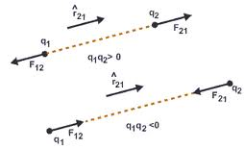

Slide 16
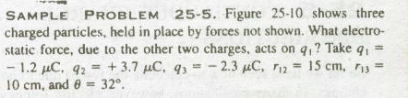

Slide 17
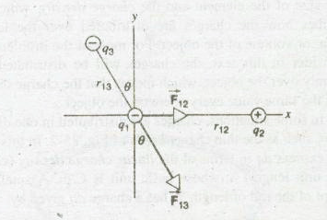

Slide 18
Continuous charge distributions
A line of charge
A ring of charge
A disk of charge

Slide 20
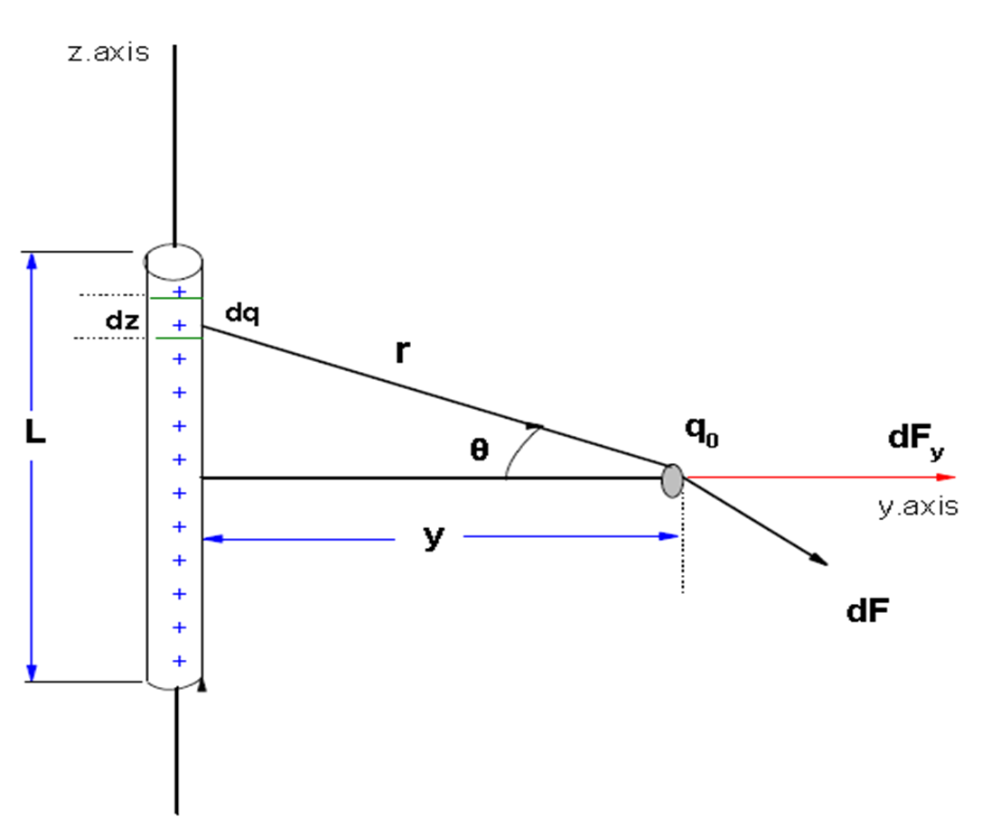
A line of charge

Slide 22
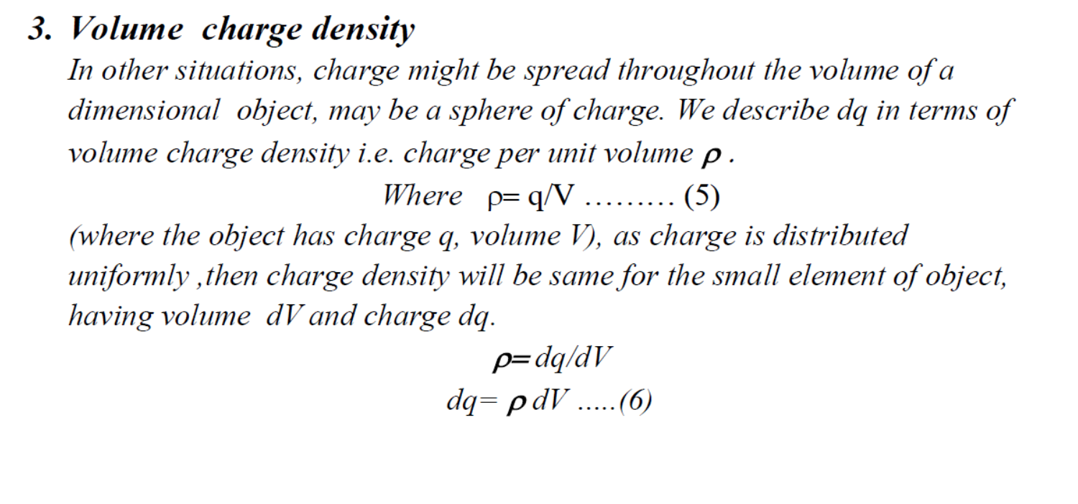

Slide 23
Units for linear charge density C/m
Units for surface charge density C/m²
Units for volume charge density C/m³

Slide 26
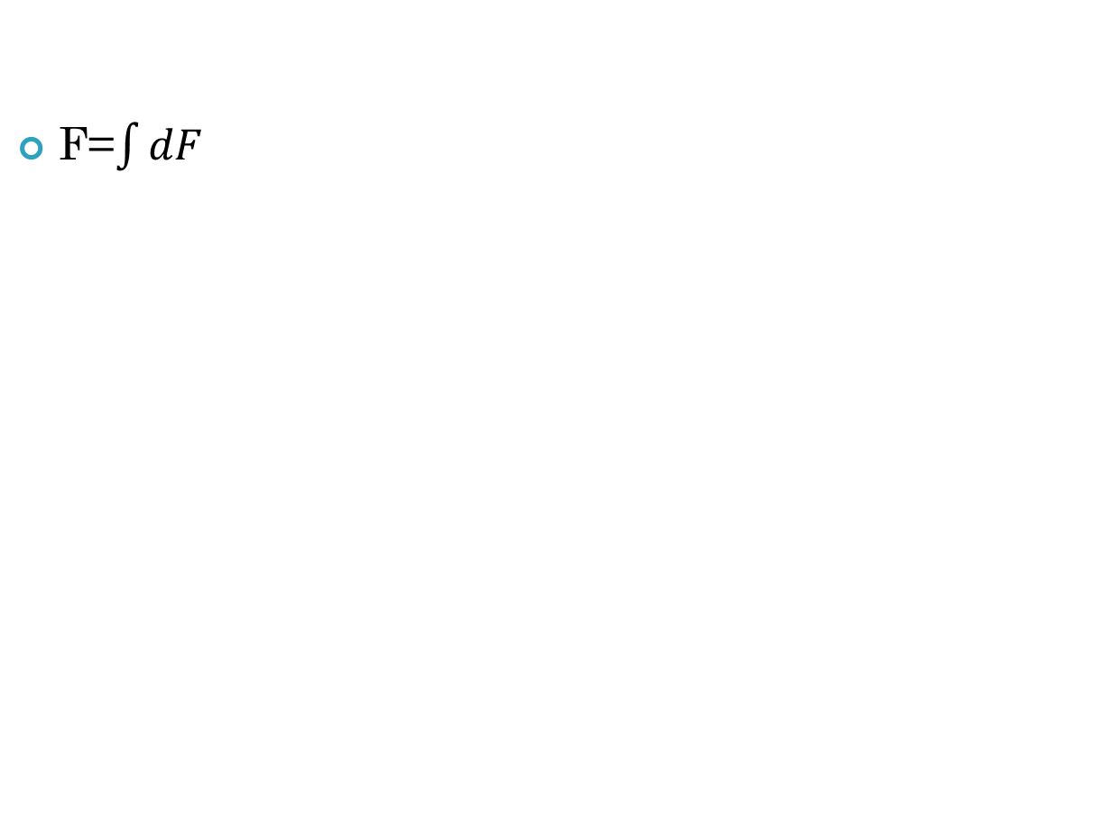
F=$\int{dF}$

Slide 27
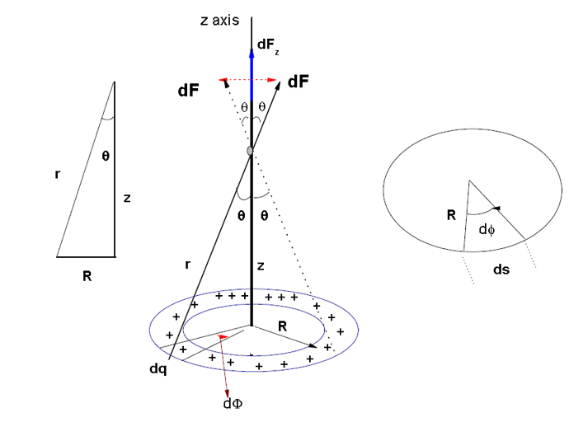
A ring of charge
Fig 3 a,b,c

Slide 29
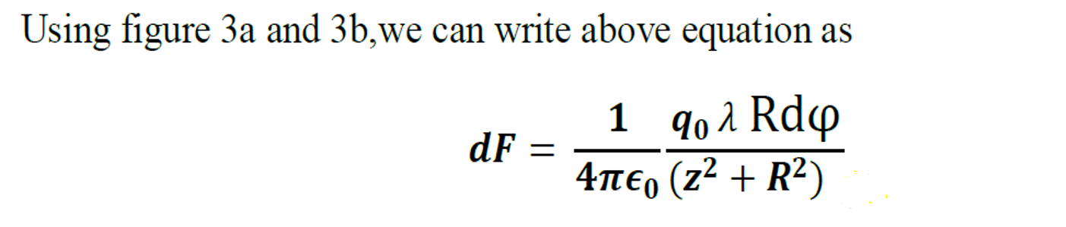
1

Slide 32

$\int_{0}^{2π}{dφ=2π}$

Slide 34
